Slide 1
Data Structures
Module 2: DMA and Linked List

Slide 2
Table of Content
Primitive Data Types
Non Primitive Data Types
Structure
DMA Functions
Singly Linked List
Doubly Linked List

Slide 3
Primitive Data Type and Non Primitive Data Type
Primitive Data Type
The primitive data types in C are those basic data types that are already defined in the C language.
These data structures can be used to store only a single value.
Example: int, float, char, double etc.
Non-Primitive Data Structures
a) The non-primitive data types in C are also known as the derived data types as they are derived from primitive ones.
b) A large number of values can be stored using the non-primitive data structures.
c) Example: Linked List, Stack, Queue, Trees, Graphs etc.

Slide 4
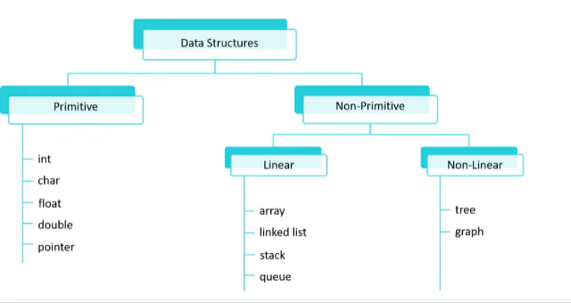

Slide 5
Structure in C
Structure is a user-defined datatype in C language which allows us to combine data of different types together.
It is somewhat similar to an Array, but an array holds data of similar type only. Structure on the other hand, can store data of any type.
Example: If I have to write a program to store Student information, which will have Student's name, age, branch, permanent address, father's name etc., which included string values, integer values etc., how can I use arrays for this problem, I will require something which can hold data of different types together.

Slide 6
Defining a structure
struct keyword is used to define a structure.
Structure defines a new data type which is a collection of primitive data type and derived data types.
Syntax:
struct [structure name]
{
//member variable 1
//member variable 2
//member variable 3
...
}[structure variables];

Slide 7
As per the syntax we can declare the structure using struct keyword.
It is optional to provide a structure name.
Inside the curly braces we can specify the member variables of different data types like int, float, string as per the requirement.
Structure variables are required to access the member variables of the structure.
The closing curly brace in the structure type declaration must be followed a semicolon.

Slide 8
Example of Structure
struct Student
{
char name[25];
int age;
char branch[10];
char gender;
};

Slide 9
Declaring Structure Variables
It is possible to declare variables of a structure, either along with structure definition or after the structure is defined.
Structure variable declaration is similar to the declaration of any normal variable of any other datatype. Structure variables can be declared in following two ways:
1) Declaring Structure variables separately.
2) Declaring Structure variables with structure definition.

Slide 10
Example 1: Declaring structure variable separately
struct Student
{
char name[25];
int age;
char branch[10];
//F for female and M for male
char gender;
};
struct Student S1, S2; //declaring variables of struct Student

Slide 11
Example 2: Declaring structure variables with definition
struct Student
{
char name[25];
int age;
char branch[10];
//F for female and M for male
char gender;
}S1, S2;

Slide 12
Accessing Structure Members
In order to access the structure member, the member name must be
Linked with the structure variable using a dot . Operator called period or member
access operator.
Example:
#include<stdio.h>
#include<string.h>
struct Student
{
char name[25];
int age;
char branch[10];
char gender;
};

Slide 13
int main()
{
struct Student s1;
s1.age = 18;
strcpy(s1.name, "Viraj");
printf("Name of Student 1: %s\n", s1.name);
printf("Age of Student 1: %d\n", s1.age);
return 0;
}
Note: To access members of a structure using pointers, we use the -> operator.

Slide 14
Programs based on structure
Program 1: Write a C program to create the structure employee (Eid, name, salary). Accept the detail of employee and display the detail of employee.
Program 2: Write a C program to create the structure customer (account no, name, balance). Accept the detail of customer and display the detail of customer.

Slide 15
Dynamic Memory Allocation
Dynamic Memory Allocation is a process in which we allocate or deallocate a block of memory during the run-time of a program.
There are four functions malloc(), calloc(), realloc() and free() present in <stdlib.h> header file.
It can also be referred to as a procedure to use Heap Memory in which we can vary the size of a variable or Data Structure (such as an Array) during the lifetime of a program using the library functions.

Slide 16
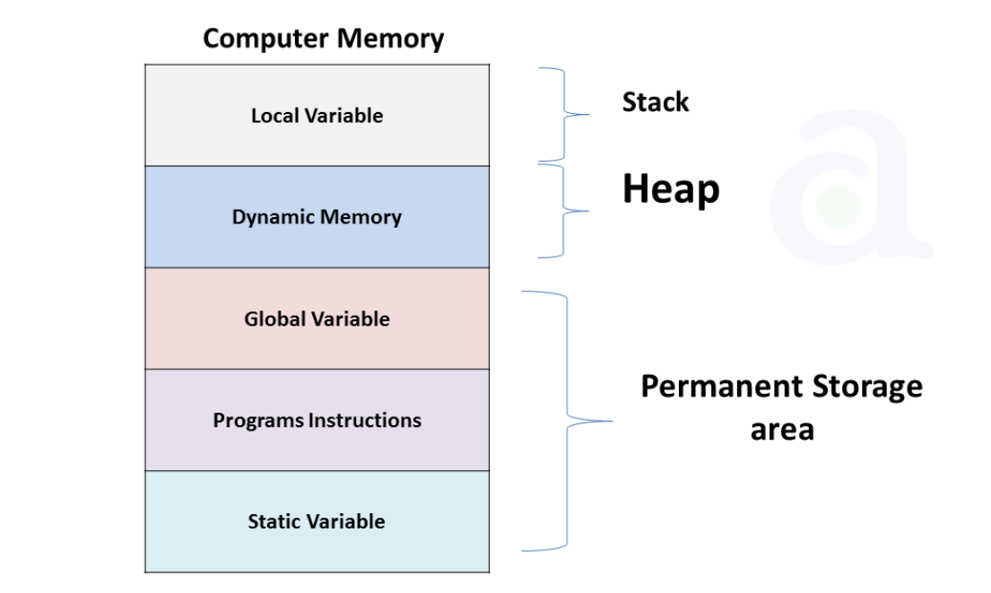

Slide 17
malloc( ) function
The malloc is a predefined library function that stands for memory allocation.
A malloc is used to allocate a specified size of memory block at the run time of a program.
It inputs the memory size (in bytes) at the run time to reserve a contiguous memory block that returns a pointer of type void, which is cast into a pointer of any form.
The dynamic memory is created using the malloc does not initialize the memory at execution time, and hence the memory block contains some default garbage value.
Syntax: pointer = ( type cast *) malloc(size);

Slide 18
calloc( ) function
A calloc() function is a predefined library function that stands for contiguous memory allocation.
A calloc() function is used to create multiple blocks at the run time of a program having the same size in the memory.
It has two parameters, no. of blocks and the size of each block.
When the dynamic memory is allocated using the calloc() function, it returns the base address of the first block, and each block is initialized with 0. And if memory is not created, it returns a NULL pointer.
Syntax: pointer = ( type cast *) calloc(number of blocks, size of each block);

Slide 19
realloc( ) and free( )
If memory is not sufficient for malloc() or calloc(), you can reallocate the memory by realloc() function. In short, it changes the memory size.
Syntax: pointer = realloc(pointer, new size);
The memory occupied by malloc() or calloc() functions must be released by calling free() function. Otherwise, it will consume memory until program exit.
Syntax: free(pointer);

Slide 20
Programs based on DMA
Program 1: Write a C program to accept 1D array from the user and calculate the sum of array elements of 1D array. Use malloc( ) function to allocate the memory at run time.
Program 2: Write a C program to accept 1D array from the user and sort the elements of an array in ascending order. Use calloc( ) function to allocate the memory at run time.

Slide 21
Singly Linked List
A Linked List is a linear data structure.
Linked List can be defined as collection of nodes that are randomly stored in the memory.
Each node in singly linked list consists of two parts
1) info/data part: It will store the data into the node.
2) link part: It will store the address of next node.
The link part of the last node in singly linked list is NULL which represents the end of singly linked list.

Slide 22
Node structure of Singly Linked List
struct node
{
int info;
struct node *link; // self referential structure
};
Self referential structure means a structure definition which includes at least one member that is a pointer to the structure of its own kind.

Slide 23
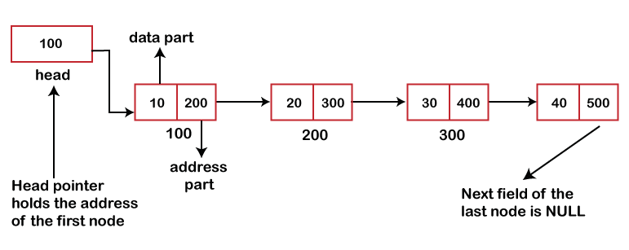
Graphical representation of singly linked list

Slide 24
Programs based on Singly Linked List
Program 1: Write a menu driven program to perform the operation on singly linked list
i) create
ii) display
iii) exit
Program 2: Write a menu driven program to perform the operation on singly linked list
i) create
ii) display
iii) Sum of elements of singly linked list
iv) exit

Slide 25
Doubly Linked List
Doubly Linked List is a variation of Linked list in which navigation is possible in both ways, either forward and backward easily as compared to Single Linked List.
Each node in Doubly linked list consists of 3 parts:
1) info part: It will store the data into the node.
2) prev part: It will store the address of previous node.
3) next part: It will store the address of next node.
The prev part of the 1st node and the next part of the last is NULL in case of doubly linked list.

Slide 26
Node structure of Doubly Linked List
struct node
{
int info;
struct node *prev; // self referential structure
struct node *next; // self referential structure
};

Slide 27
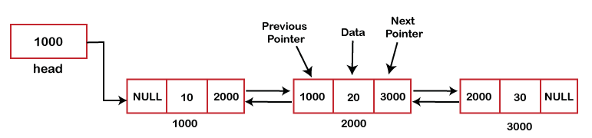
Graphical representation of doubly linked list

Slide 28
Programs based on Doubly Linked List
Program 1: Write a menu driven program to perform the operation on doubly linked list
i) create
ii) display
iii) exit
Program 2: Write a menu driven program to to perform the operation on DLL.
i) create
ii) display
iii) Count the number of even and odd elements from DLL
iv) exit

Slide 29
Thank you

